Slide 1

I
A Mini Project
Web Application Development
Project title: A Food Blog.
Faculty In-charge : Nalina V
Moksh Jayanth G R - 1BM19IS094
Mohan D - 1BM19IS094
January 25, 2021
MINI PROJECT | FOOD BLOG

Slide 2
Aim
II
The Main Aim and Objective of our project is to build full functioning food blog where in an user can create his/her account and login, get access to numerous food recipes of their interest.
Yet another main Objective of the project is to create an user interactive website where in the users can also upload recipes of their own favourite food item and further contribute to the blog by making it more informative.

Slide 3
Objective
III
This project's main and foremost objective is to build a very interactive website which focuses on providing the user with nice and pleasant experience while using the site.
The following are the primary objectives of the project:
To build a website which is interactive with the users using Java script, PHP and minified jQuery libraries.
To build a website with an eye-catchy design by using Google's MATERIALIZE CSS Frameworks.
To build an very informative food blog, providing the users with good informative description of the food recipes along with lots of food Images and video content.
To build an website with very easy user interface, easy to navigate website.
To build an website where in an user can also upload their own food recipes into our blog.

Slide 4
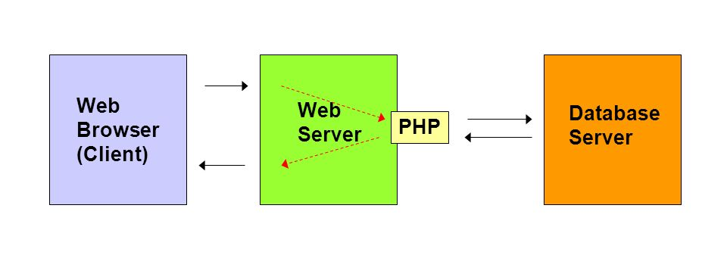
System Architecture
IV
Front-end
The Web browser is designed using HTML & CSS with some of the Materialize CSS tools. Along with several functions of JavaScript.
Back-end
Web server : APACHE & Database server : MySQL.
The PHP is used to interact with both the Web server & Database server.

Slide 5

V
Results
We successfully created a blog which has a very easy user interface .
Easy user interface of the blog was achieved by using bold, more colourful and bright clickable buttons for this site. Using a navigation bar at the top made navigating to different sections of blog very easy.
We successfully created a blog which is more interactive.
The blog is interactive. Users can create their accounts of the blog and use it to login.
After logging in the user can get access to lots of features such as :
printing the recipes of their favorite food item into a hard copy.
saving the the recipes into a soft copy(.pdf format)
Also the users can share their own food recipes into the blog (which is very cool).
And also the website is compatible for all ranges of screen-sizes. The website is completely operational on mobile screens as well as large TV screens.
We successfully created a blog with an eye-catchy design
With the help of MATERIALIZE CSS Frameworks and jQuery, a very good design of the website was achieved.
We have included bright and colorful buttons along with Google's material icons.
Also we have included lots of other features like sweet scrolling, modals, tabs, cards etc.

Slide 6
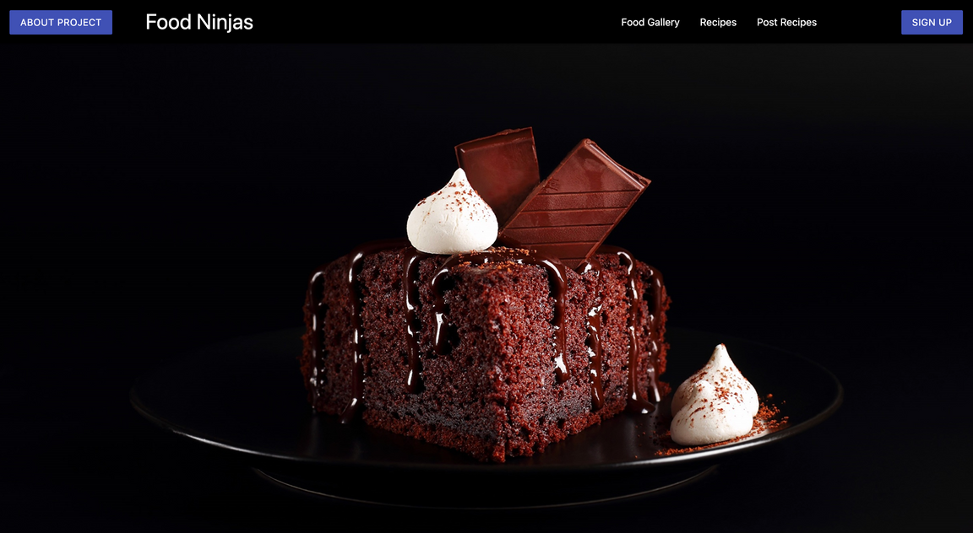
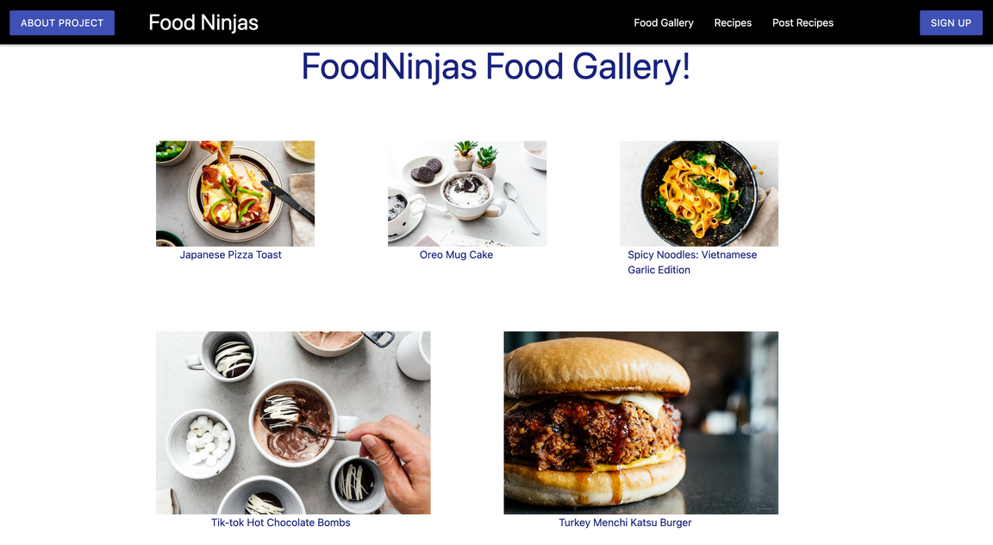
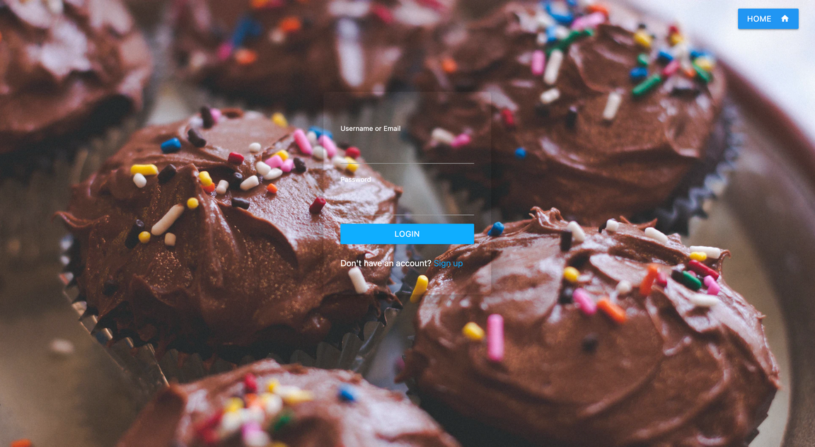
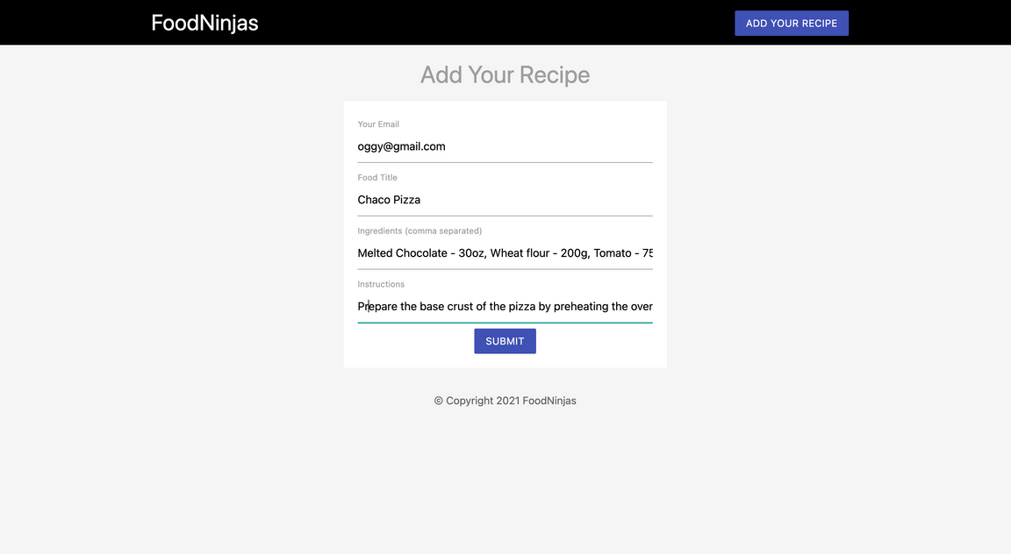
XI
Few Images of our completed Project.
The Home page.
Food Gallery Section.
Login Form
Post Recipe Form

Slide 7
Conclusion
VI
Further Improvements of the Project
Functioning of the site.
There is always room for improvements, a lots improvements can be done, like the blog can be made more interactive by adding a comment section where in the users can discuss their views on the food recipes, adding the like count for a particular food recipe, adding a recipe to their favourite-list and much more.
We were able to build a full functioning mini food-blog. Cloud databases such a Firestore database, IBM database etc, were more efficient and better
options to build this mini-project, but we indeed had to demonstrate the concepts which we learnt in the classes, so we chose to host the database
locally.
User's experience enhanced
Final few words
The website is designed in such a way that it provides the user a very elegant and pleasent experience.
We made the website's design and layout as interactive as possible using the concepts that we have learnt in classes and using few of online frameworks. But has said before, there is always a room for improvement.

Slide 8
THANK YOU AND HAVE A GREAT DAY.
VII
"Experience is simply the name we give our mistakes"
TH
- Oscar Wilde

